Slide 1
Synthesis of Environmentally-Responsive Composite Core-Shell Nanoparticles via One-Step Pickering Emulsion Polymerization
Stefen Hillman
Chemical Engineering
Arizona State University
April 21th, 2012

Slide 2
Outline
Introduction
  Applications
  Synthesis Summary
Results and Discussion
  Surface Morphology
  Temperature-Sensitivity
Conclusion

Slide 3
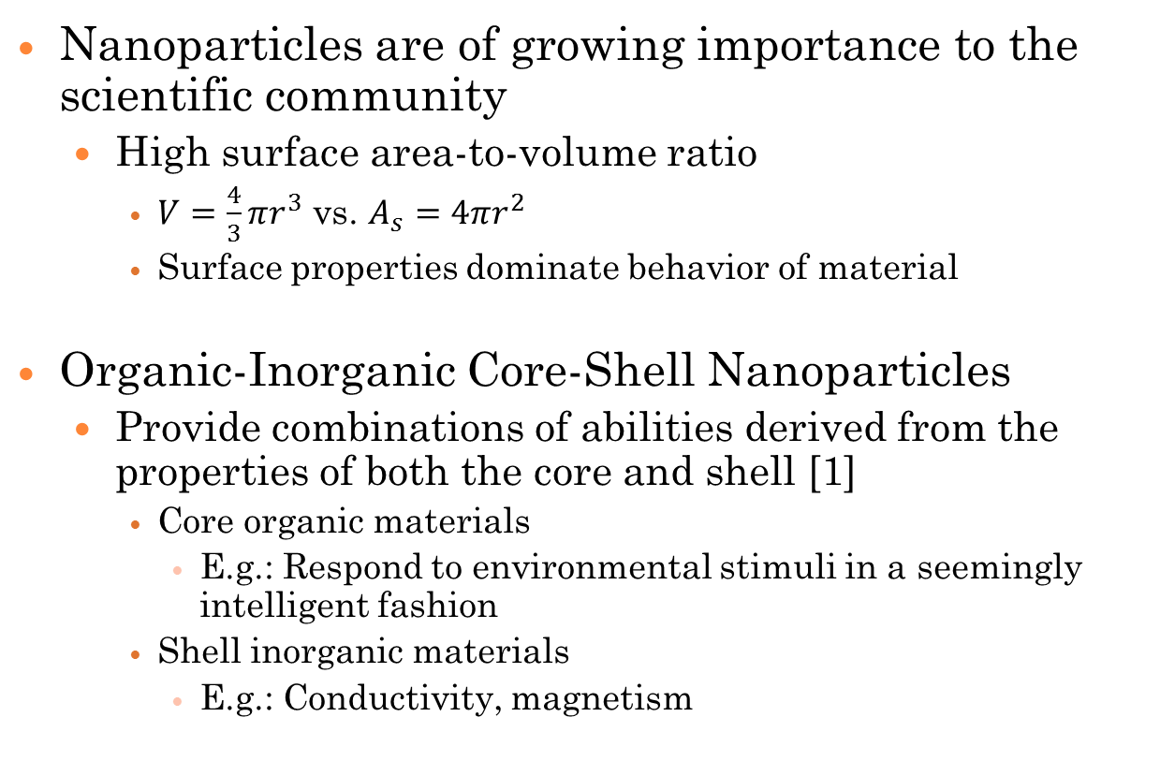
Introduction
Nanoparticles are of growing importance to the scientific community
  High surface area-to-volume ratio
    $V=\frac{4}{3}πr^{3}$ vs. $A_{s}=4πr^{2}$
    Surface properties dominate behavior of material
Organic-Inorganic Core-Shell Nanoparticles
  Provide combinations of abilities derived from the properties of both the core and shell [1]
    Core organic materials
      E.g.: Respond to environmental stimuli in a seemingly intelligent fashion
    Shell inorganic materials
      E.g.: Conductivity, magnetism

Slide 4
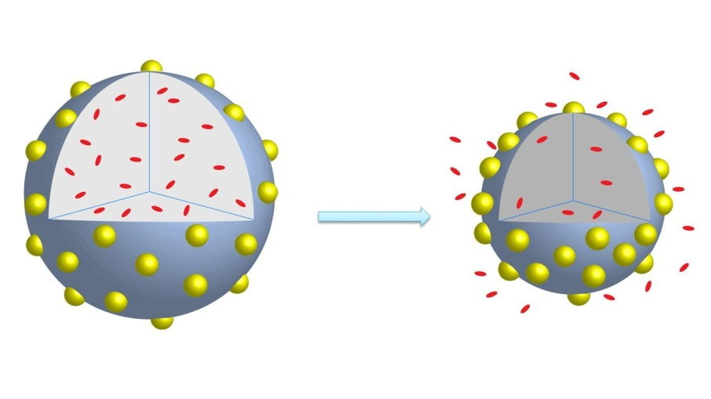
Applications
“Smart” particles
  Volume change response to environmental stimuli
Drug Delivery
  Direct, controlled, in-situ cancer drug delivery
Release of encapsulated materials from nanoparticles

Slide 5
Synthesis Method
Why this synthesis method?
  One-step
  Simple
  No surfactants
Preparation Step: Pickering Emulsion
Reaction Step: Radical Polymerization
B
B
A
A
Solid particle
Surfactant
Pickering emulsion
Traditional emulsion

Slide 6


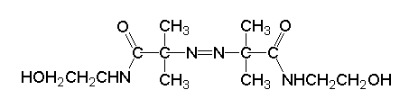
Materials
Monomers
  Styrene
  N-isopropylacrylamide (NIPAAm)
Solid Nanoparticles
  Silicon dioxide (Silica)
Radical Initiator
  2,2-azobis(2-methyl-N-(2-hydroxyethyl)propionamide (VA-086)

Slide 7
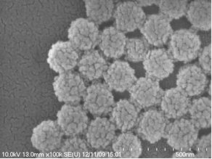
Results: PS/PNIPAAm-Silica NP’s
SEM image of 50/50% PS/PNIPAAm-Silica nanoparticles.
Diameter is 150-175 nm.

Slide 8
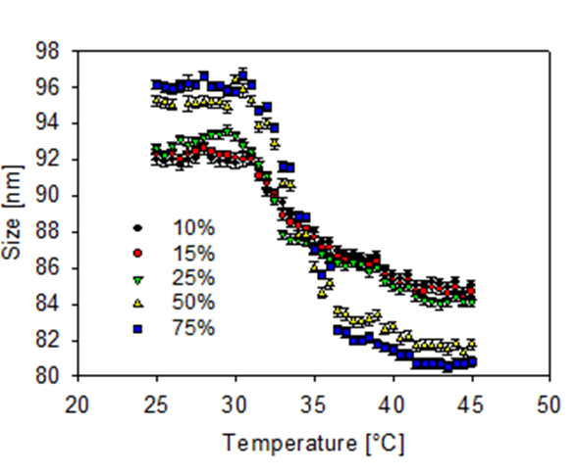
Results: Temperature-Sensitivity
Temperature-response of PS/PNIPAAm-Silica nanoparticles of varying composition.

Slide 9
Conclusion
Temperature-sensitive particles were successfully synthesized
  PS/PNIPAAm-Silica Particles
    Decrease diameter in response to temperature increase
    Transition temperature at the LCST of 32 °C
    Increasing percentage of NIPAAm increases transition size
Future work
  Transition temperature tuning for biological applications
Notes:
Verbal: “Future work will go into tuning these particles for specific applications”

Slide 10
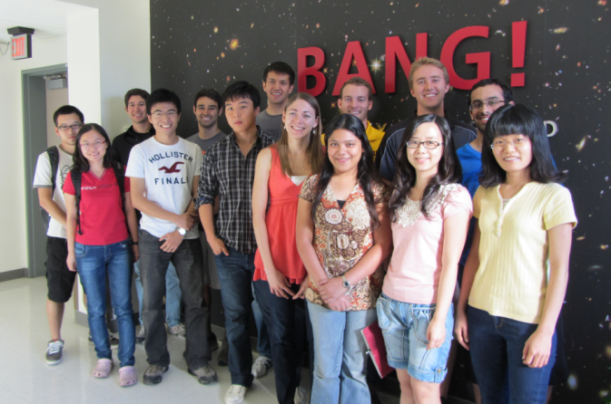


Acknowledgements
Dr. Lenore Dai
Dai Research Group
Funding:

Slide 11
References
[1] Janczak, C.M., Aspinwall, C.A. “Composite nanoparticles: the best of two worlds”. Anal. Bioanal. Chem. 402, 83-89. 2012.
[2] Reusch, W. “Polymers”. Virtual Text of Organic Chemistry. Dept. of Chemistry, Michigan State University. 1999.
[3] Ma, H., Luo, M., Sanyal, S., Rege, K., Dai, L. “The One-Step Pickering Emulsion Polymerization Route for Synthesizing Organic-Inorganic Nanocomposite Particles.” Materials. 3, 1186-1202. 2010.
[4] Ma, H., Dai, L. “Synthesis of Polystyrene-Silica Composite Particles via One-Step Nanoparticle-Stabilized Emulsion Polymerization”. J. Colloid Interface Sci. 333, 2, 807-811. 2009.
[5] Pennadam, S.S., Firmann, K., Alexander, C., Gorecki, D.C. “Protein- polymer nano-machines. Towards synthetic control of biological processes”. J. Nanobiotechnology. 2, 8. 2004.
[6] Clark, J. “Introducing Amines”. Chemguide. 2009.

Slide 12

Thank you!

Slide 13
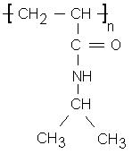
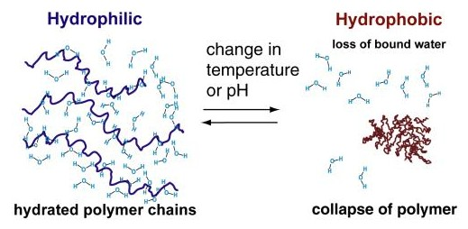
Lower Critical Solution Temperature (LCST)
PNIPAAm
Temp. Increase
Temp. Decrease
[5]
At the LCST, the interactions between hydrophobic polymer segments overcome the hydrogen bonding between the polymer and water (hydrophilic interactions), leading to a decrease in polymer volume as water is expelled and separation of phases.
Notes:
Essentially, below the LCST, hydrophilic interactions dominate, whereas above, hydrophobic interactions dominate. You end up with one polymer-rich phase and one polymer-poor phase.

Slide 14
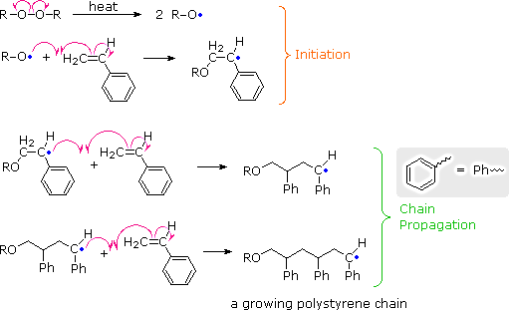
Reaction Mechanism
Radical Polymerization
2,2-azobis(2-methyl-N-(2-hydroxyethyl)propionamide (VA-086)
[2]

Slide 15
Procedure
Synthesis
  Form Pickering Emulsions
    Mix styrene, comonomer, and silica in water using mechanical agitation
  Start polymerization reaction
    Heat emulsion to 70 °C in a nitrogen atmosphere
    Add radical initiator, VA-086
    Allow to react, with constant temperature, agitation, and inert atmosphere, for five hours
  Washing
    Centrifuge, replace supernatant with water, redisperse, and repeat
Characterization
  Scanning Electron Microscopy (SEM)
  Dynamic Light Scattering (DLS)
  Rheometry

Slide 16
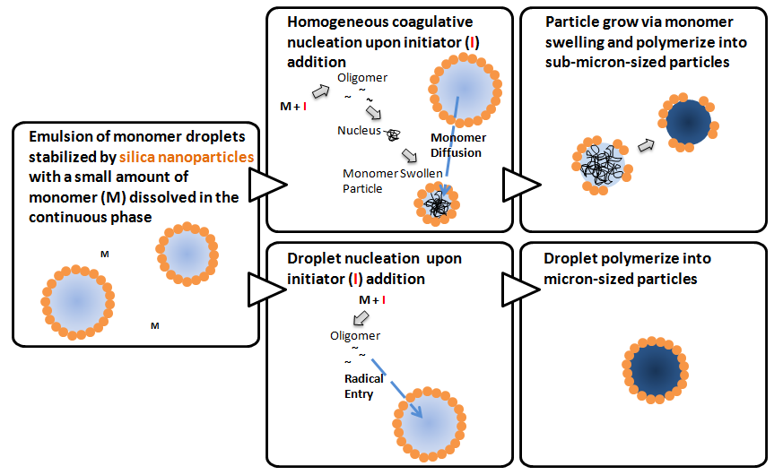
Possible Synthesis Mechanism [3]

Slide 17
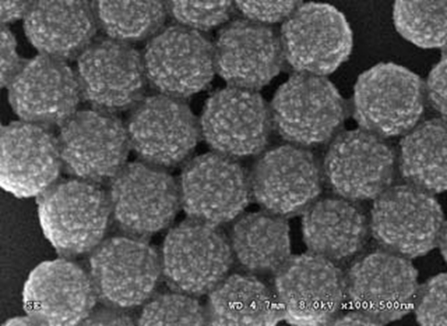

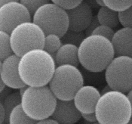




Model Particles: PS-Silica [4]
Left: SEM image of PS-Silica particles. Diameter is 150-175 nm.
Center: TEM image of cross-sectioned PS-Silica particles.
Right: SEM image of PS-Silica particles after etching with HF acid.

Slide 18
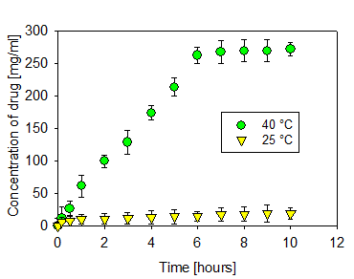
Results: Drug Release
Left: Release of cancer drug from 50/50% PS/PNIPAAm-Silica particles at two different temperatures.
Right: Release of cancer drug from PS/PNIPAAm-Silica particles of varying compositions at 40 °C.

Slide 19
Alternate Synthesis Methods
Layer-by-Layer Self Assembly
Post-Surface Reaction
Electrostatic Deposition
Nanoprecipitation
General Disadvantages
  Extreme number of steps and separate processes
  Longer time commitments
  Require great varieties of different materials and methods
  Some processes require additional PPE or extensive use of toxic/dangerous chemicals

